Slide 1
Analysis for part 1 (overview)
Dec – 12 -- 2023

Slide 2
Dynamic.

Slide 3
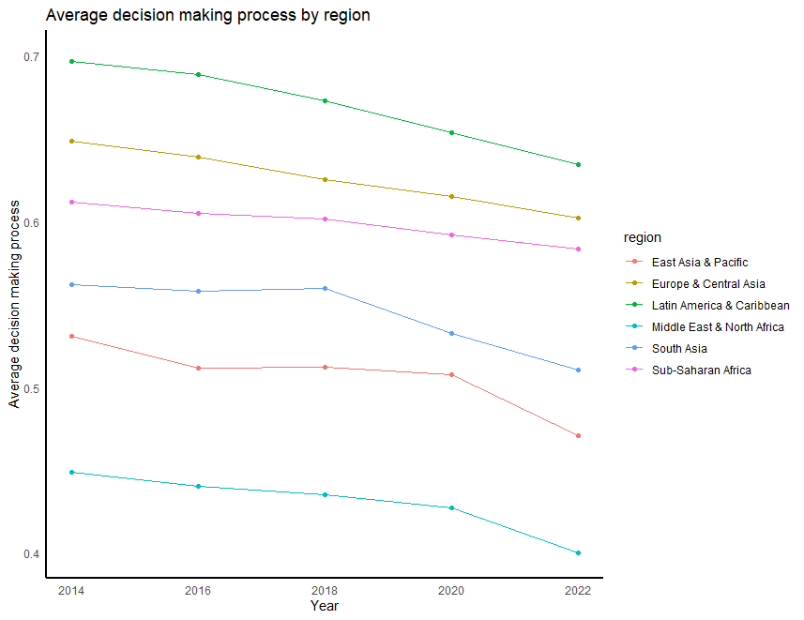
Decision making process/dmp: The list of variables in the notes below.
Notes:
egen missing_dmp=rownonmiss (bs_bti_q2_3 bs_bti_si wjp_rol_1 bs_bti_q3_1 vdem_core_v2xlg_legcon bs_bti_q2_1 fh_fiw_pr_rating vdem_core_v2pepwrses vdem_core_v2pepwrsoc vdem_core_v2pepwrgen vdem_core_v2x_gender fh_fiw_cl_rating bs_bti_q2_3 vdem_core_v2cacamps rwb_pfi_index vdem_core_v2x_cspart vdem_core_v2cseeorgs vdem_core_v2csreprss vdem_core_v2dlengage wjp_rol_4_7 vdem_core_v2clacfree wjp_rol_4_5 wjp_rol_4_4 wjp_rol_4_6 vdem_core_v2cldiscm vdem_core_v2cldiscw wb_wbl_social)
egen dmp_27=rowmean(bs_bti_q2_3 bs_bti_si wjp_rol_1 bs_bti_q3_1 vdem_core_v2xlg_legcon bs_bti_q2_1 fh_fiw_pr_rating vdem_core_v2pepwrses vdem_core_v2pepwrsoc vdem_core_v2pepwrgen vdem_core_v2x_gender fh_fiw_cl_rating bs_bti_q2_3 vdem_core_v2cacamps rwb_pfi_index vdem_core_v2x_cspart vdem_core_v2cseeorgs vdem_core_v2csreprss vdem_core_v2dlengage wjp_rol_4_7 vdem_core_v2clacfree wjp_rol_4_5 wjp_rol_4_4 wjp_rol_4_6 vdem_core_v2cldiscm vdem_core_v2cldiscw wb_wbl_social) if missing_dmp==27
collapse dmp_27 if dummy_dmp==1 , by (region year)
drop if dmp_27 ==.
Note: collapse command output, I exported to xls and prepare chart in R program.
Do file is attached : Dynamic_dec_4.do (line # 14 – 96)

Slide 4
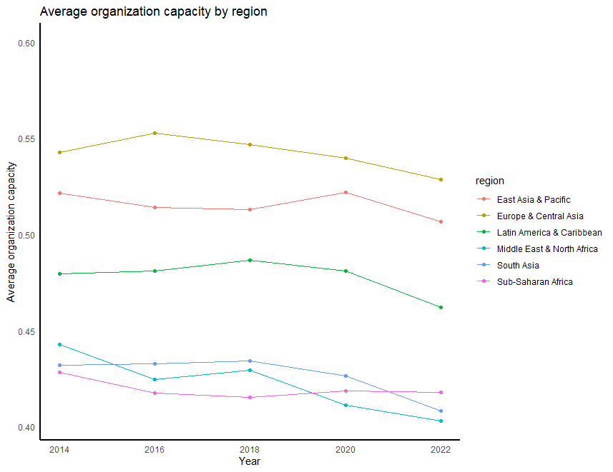
Organization capacity/og: The list of variables in the notes
Notes:
egen missing_og=rownonmiss(wjp_rol_3_2 wjp_rol_3_1 wjp_rol_3_4 wjp_rol_7_6 wjp_rol_7_5 bs_bti_q15_1 vdem_core_v2stcritrecadm vdem_core_v2peasjpol vdem_core_v2peasjsoecon)
egen og_9=rowmean(wjp_rol_3_2 wjp_rol_3_1 wjp_rol_3_4 wjp_rol_7_6 wjp_rol_7_5 bs_bti_q15_1 vdem_core_v2stcritrecadm vdem_core_v2peasjpol vdem_core_v2peasjsoecon ) if missing_og==9
collapse og_9 if dummy_og==1 , by (region year)
drop if og_9 ==.
Note: collapse command output, I exported to xls and prepare chart in R program.
Do file is attached : Dynamic_dec_4.do (line # 14 – 96)

Slide 5
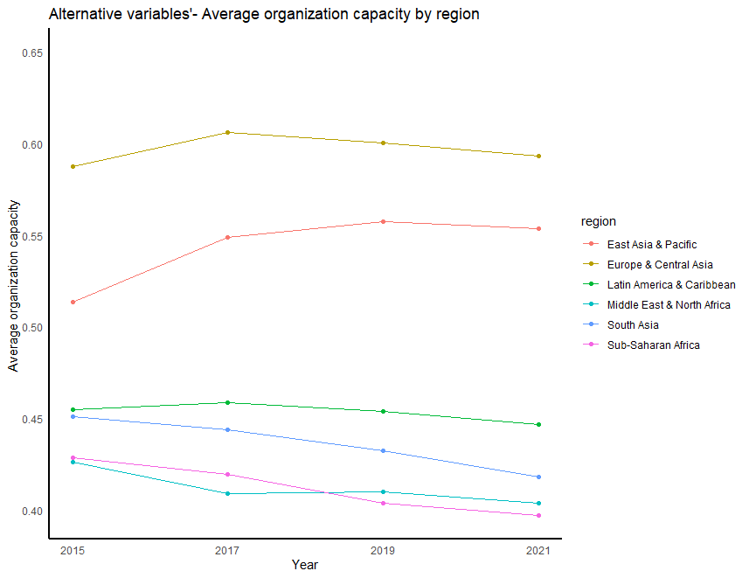
Alternative version of dynamic org capacity that includes only
vdem_core_v2peasjpol vdem_core_v2stcritrecadm vdem_core_v2peasjsoecon rise_ee_4 wjp_rol_3_2 wjp_rol_3_4 wjp_rol_3_1 ibp_obs_obi

Slide 6
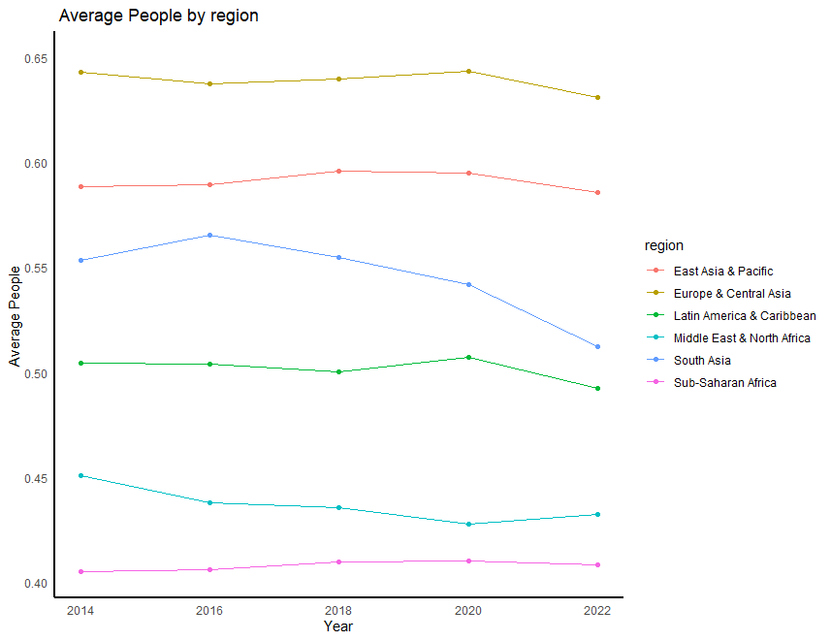
Dynamic // People: vdem_core_v2peasjsoecon: access to state jobs by socio-economic position. vdem_core_v2stcritrecadm: criteria for appointment decisions in the state administration. vdem_core_v2peasjpol: Access to state jobs by political group.

Slide 7
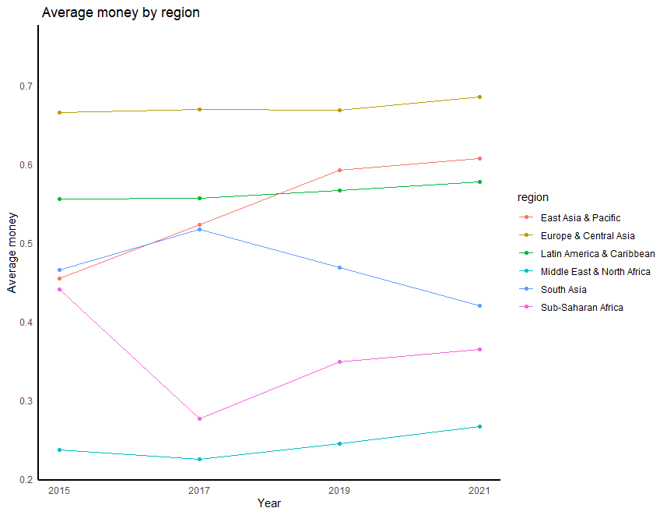
Dynamics : civil society variable: //Open Budget Index: ibp_obs_obi //Incentives and mandates: Public sector:rise_ee_4

Slide 8
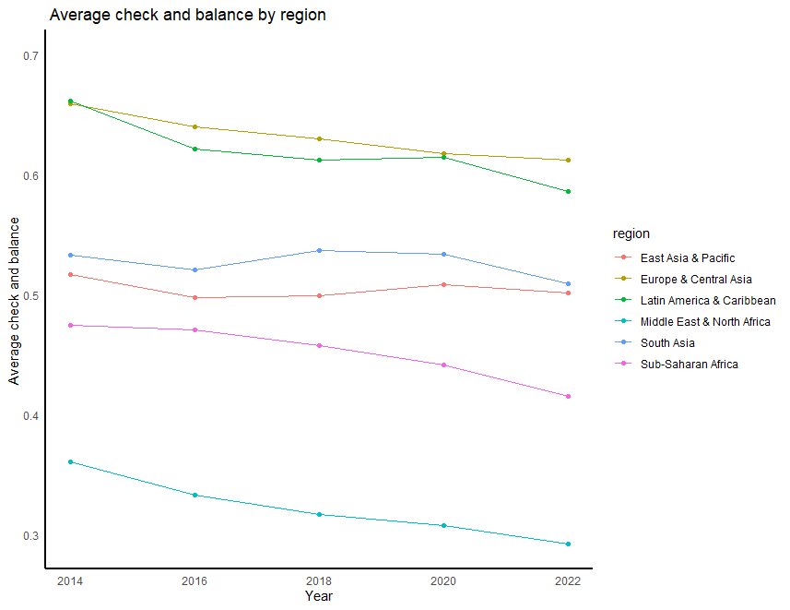
Dynamic: Check and balance variable : bs_bti_q2_1: Free and fair elections bs_bti_q3_1: Separation of powers bs_bti_si: Democracy Status vdem_core_v2xlg_legcon: legislative constraints on the executive index wjp_rol_1: Constraints on Gov. Powers

Slide 9
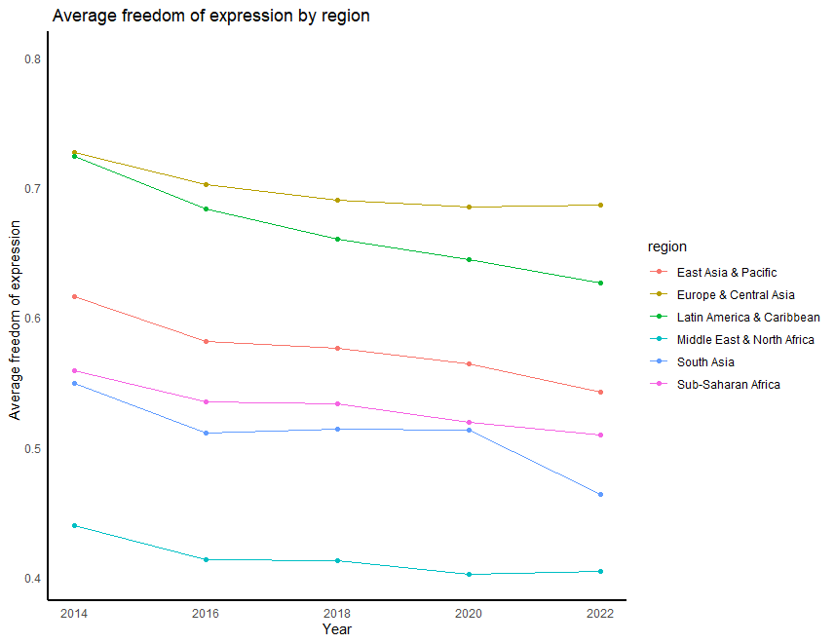
Dynamic: freedom of expression variable //wjp_rol_4_5:Freedom of belief and religion //"wjp_rol_4_4:Freedom of opinion and expression //"wjp_rol_4_6:Freedom from arbitrary interference with privacy //"vdem_core_v2cldiscm:Freedom of discussion for men //"vdem_core_v2cldiscw:Freedom of discussion for women

Slide 10
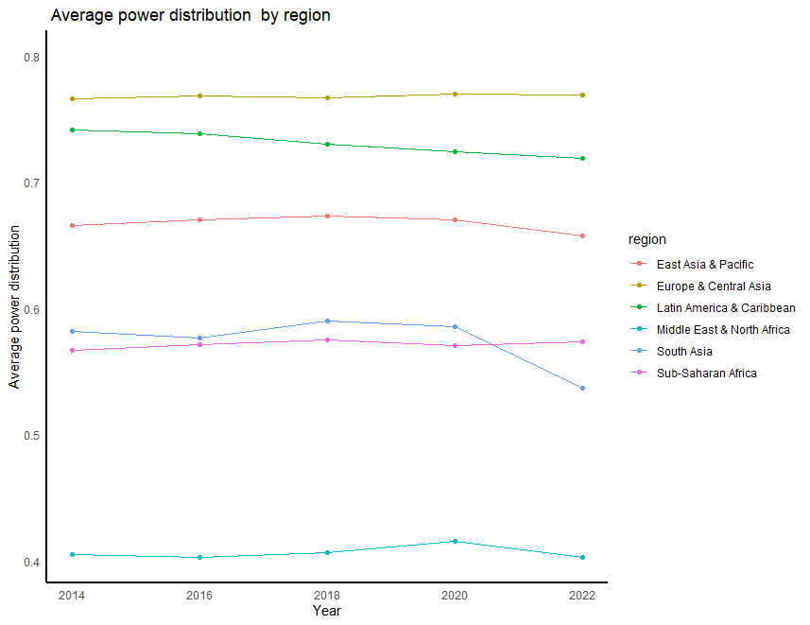
Dynamic: power distribution var fh_fiw_pr_rating: Political Rights vdem_core_v2pepwrses:Power distributed by socio-economic position vdem_core_v2pepwrsoc:Power distributed by social group vdem_core_v2pepwrgen:Power distributed by gender vdem_core_v2x_gender:Women political empowerment index wb_wbl_social: Women's Social Equality Index

Slide 11
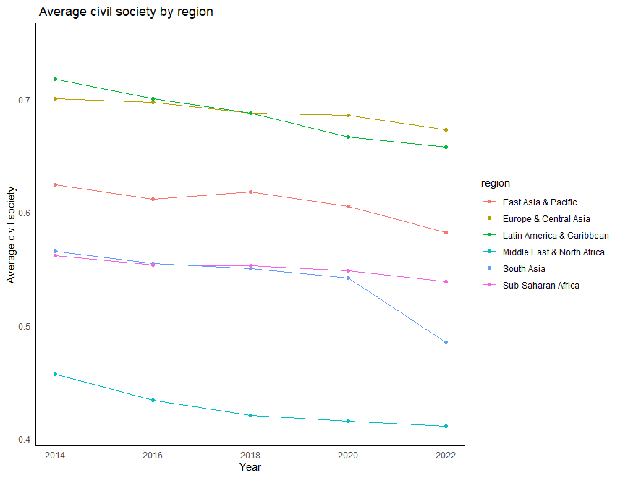
Dynamic: civil society variable //fh_fiw_cl_rating:Civil Liberties //"bs_bti_q2_3:Association and assembly rights //"vdem_core_v2cacamps:Political polarization //"vdem_core_v2x_cspart:Civil society participation //"vdem_core_v2cseeorgs:CSO entry and exit/Social Institutions //"vdem_core_v2csreprss:CSO repression/Social Institutions //"vdem_core_v2dlengage:Engaged society //"wjp_rol_4_7:Freedom of assembly and association

Slide 12
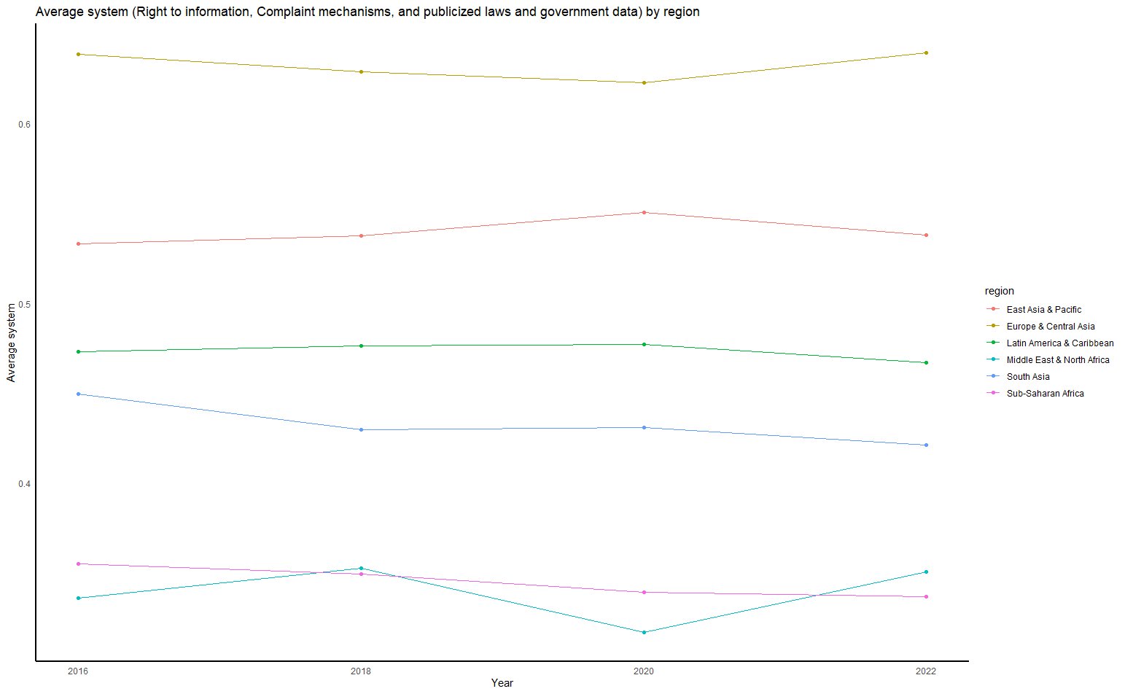
Dynamic: System //wjp_rol_3_2:Right to information //"wjp_rol_3_4:Complaint mechanisms //"wjp_rol_3_1:Publicized laws and government data

Slide 13
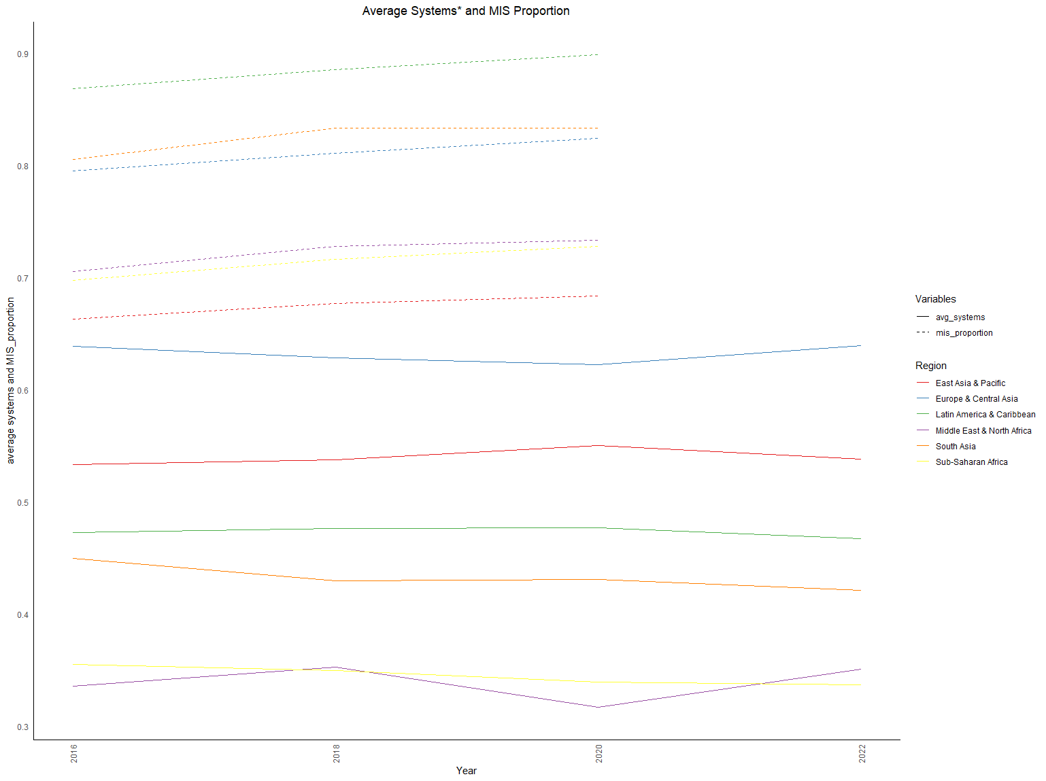
Dynamic: System //wjp_rol_3_2:Right to information //"wjp_rol_3_4:Complaint mechanisms //"wjp_rol_3_1:Publicized laws and government data and MIS proportion. *total 9 FMIS, Customs, Tax MIS, Debt Mgt, Treasury Single Account (TSA), eProcurement , Payroll ,HRMIS system, and Public Investment Management Systems

Slide 14
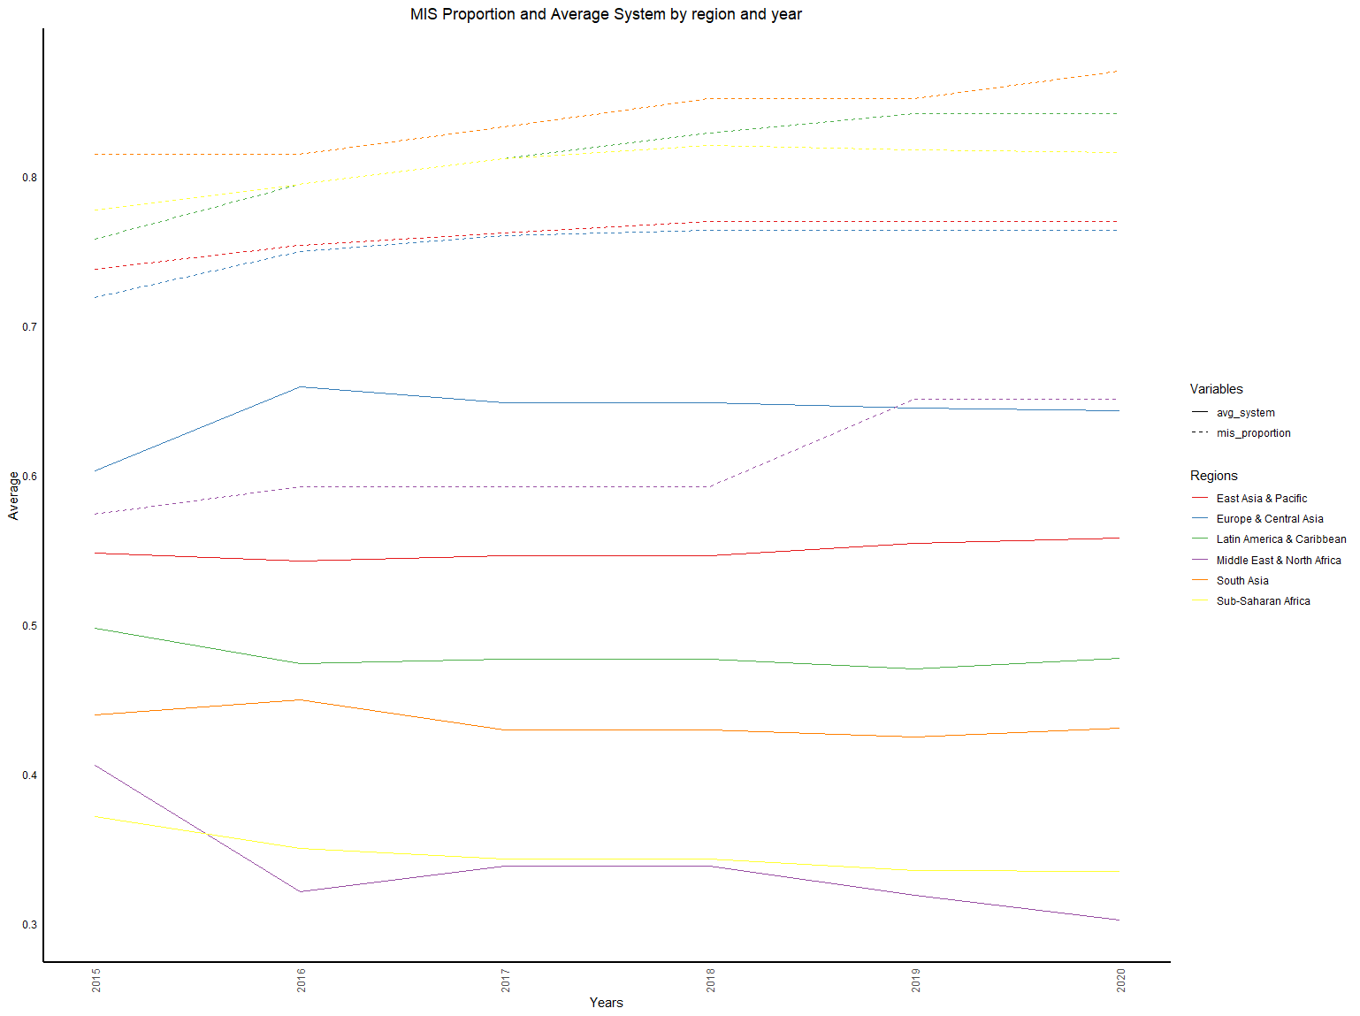
1. wjp_rol_3_2:Right to information 2. wjp_rol_3_4:Complaint mechanisms 3. wjp_rol_3_1:Publicized laws and government data 4. proportion of MIS

Slide 15
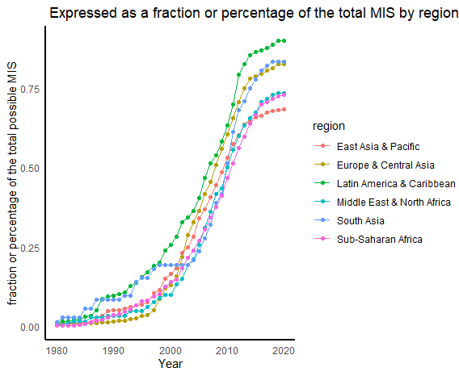
Note: Total 9 FMIS, Customs, Tax MIS, Debt Mgt, Treasury Single Account (TSA), eProcurement , Payroll ,HRMIS system, and Public Investment Management Systems. Code is below
Notes:
gen mis_count = dummy_op + dummy_cmis + dummy_tmis + dummy_dms + dummy_tsa + dummy_eprc + dummy_payr + dummy_hrm + dummy_pims
//express the count as a fraction or percentage of the total possible MIS,
gen mis_proportion = mis_count / 9
//Or, for a percentage:
gen mis_percentage = (mis_count / 9) * 100
collapse mis_proportion, by (region year)
drop if region== "North America"
save mis_proportion, replace

Slide 16
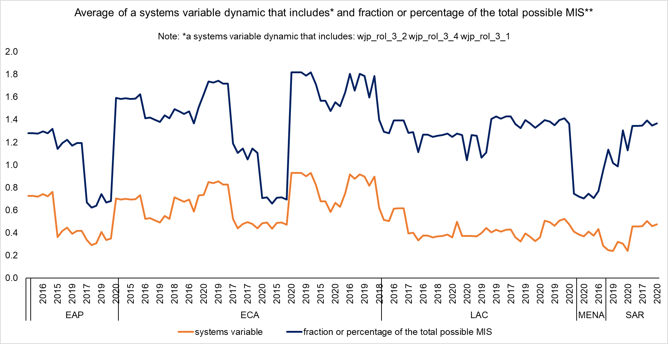
Chart shows avg of system by region and proportion of the MIS Note: Total 9 FMIS, Customs, Tax MIS, Debt Mgt, Treasury Single Account (TSA), eProcurement , Payroll ,HRMIS system, and Public Investment Management Systems. and – system by region wjp_rol_3_2:Right to information wjp_rol_3_4:Complaint mechanisms wjp_rol_3_1:Publicized laws and government Mgy system? WPJ; 2013 –Check and add many years t data ==1 three things 10 – charts 20 – MIS add variable 3-regression (freedom of exp, etc)

Slide 17
STATIC

Slide 18
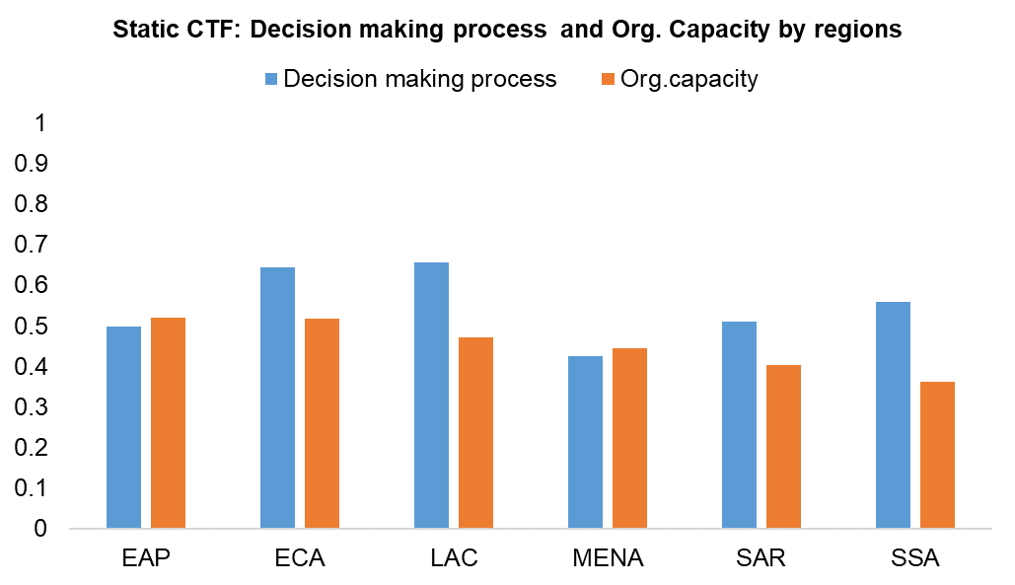
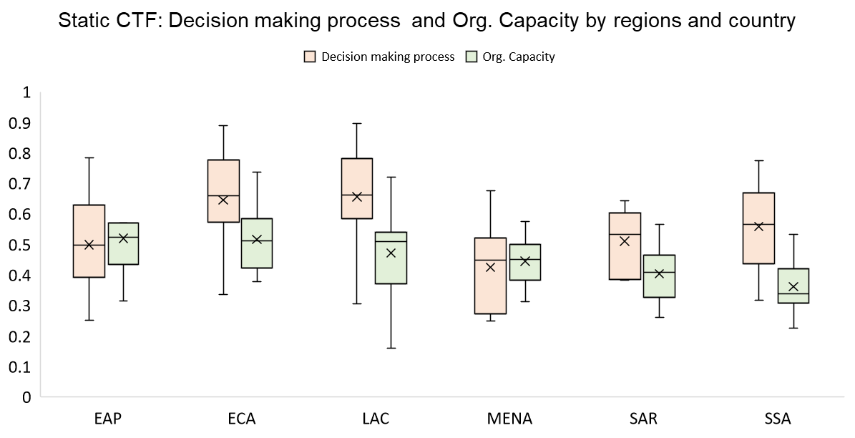
Footnote: Average calculated for 11 EAP, 25 ECA, 21 LAC, 8 MENA, 8 SAR, and 34 SSA countries.

Slide 19
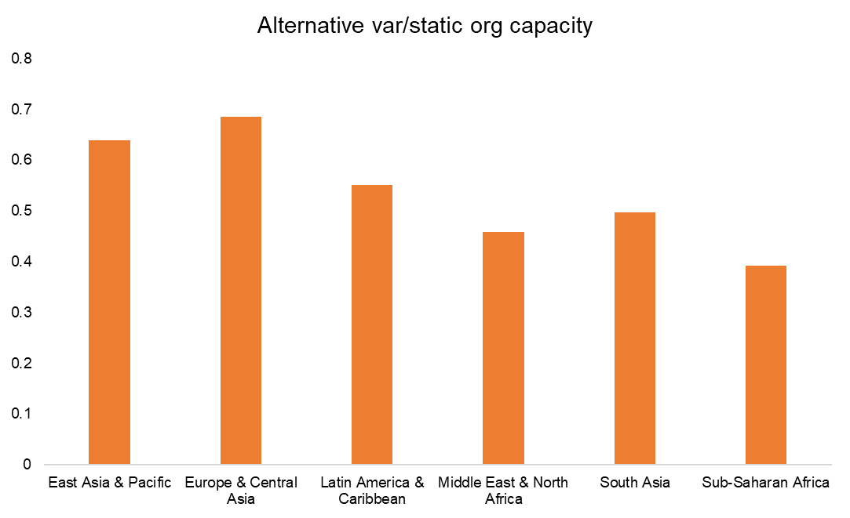
//wb_gtmi_gtei :GovTech Enablers Index (GTEI)
// wb_gtmi_psdi :Public Service Delivery Index (PSDI)
// wb_gtmi_dcei :Digital Citizen Engagement Index score
// wb_gtmi_cgsi : Core Government Systems Index (CGSI)
// spi_census_and_survey_index :Censuses and Surveys
// spi_std_and_methods : Standards and Methods
// vdem_core_v2peasjpol :Access to state jobs by political group
// vdem_core_v2stcritrecadm : Criteria for appointment decisions in the state administration
// vdem_core_v2peasjsoecon :Access to state jobs by socio-economic position
// rise_ee_4 :Incentives and mandates: Public sector
// wjp_rol_3_2 :Right to information
// wjp_rol_3_4 :Complaint mechanisms
// wjp_rol_3_1 :Publicized laws and government data
// ibp_obs_obi:Open Budget Index

Slide 20
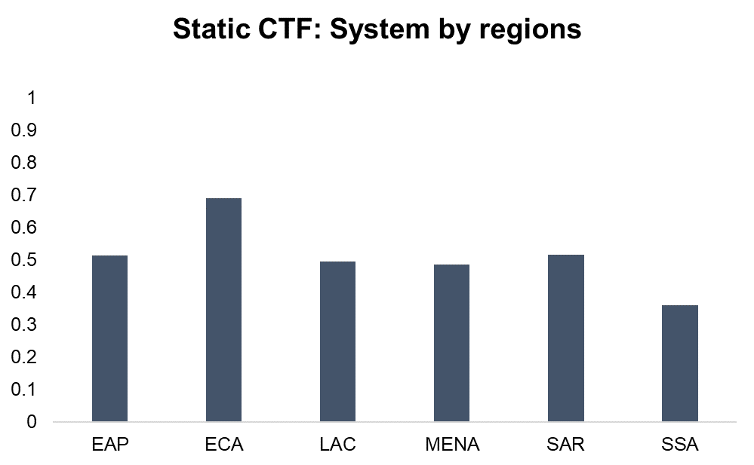
// wb_gtmi_gtei : GovTech Enablers Index (GTEI)
// wb_gtmi_psdi :Public Service Delivery Index (PSDI)
// wb_gtmi_dcei :Digital Citizen Engagement Index score
// wb_gtmi_cgsi :Core Government Systems Index (CGSI)
// spi_census_and_survey_index :Censuses and Surveys
// spi_std_and_methods :Standards and Methods
// wjp_rol_3_2 :Right to information
// wjp_rol_3_4 :Complaint mechanisms
// wjp_rol_3_1: Publicized laws and government data

Slide 21
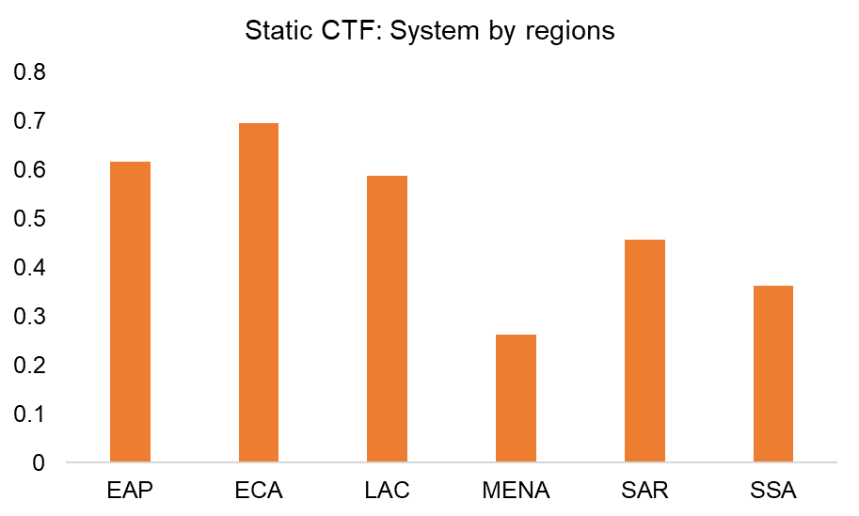
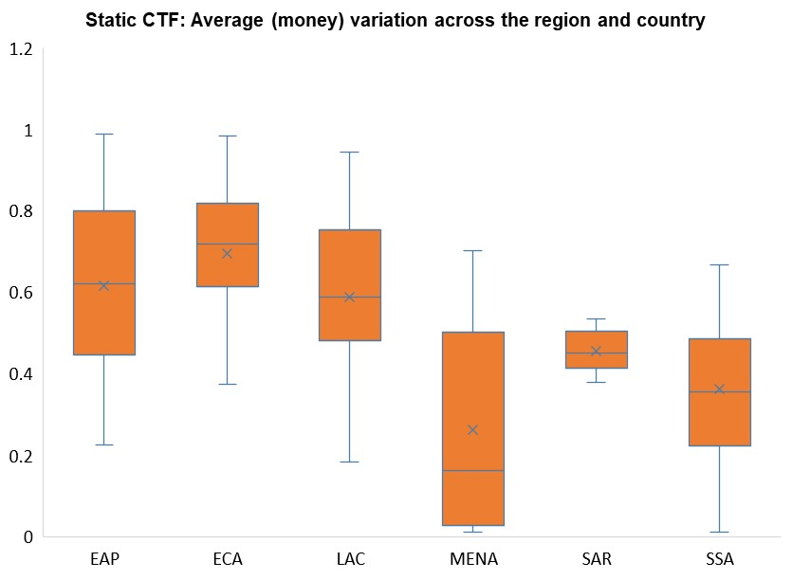
Money variable static that includes rise_ee_4 ibp_obs_obi

Slide 22
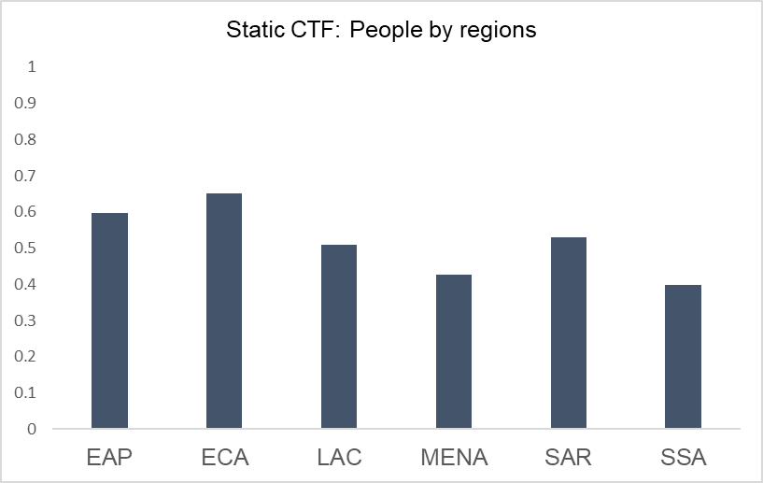
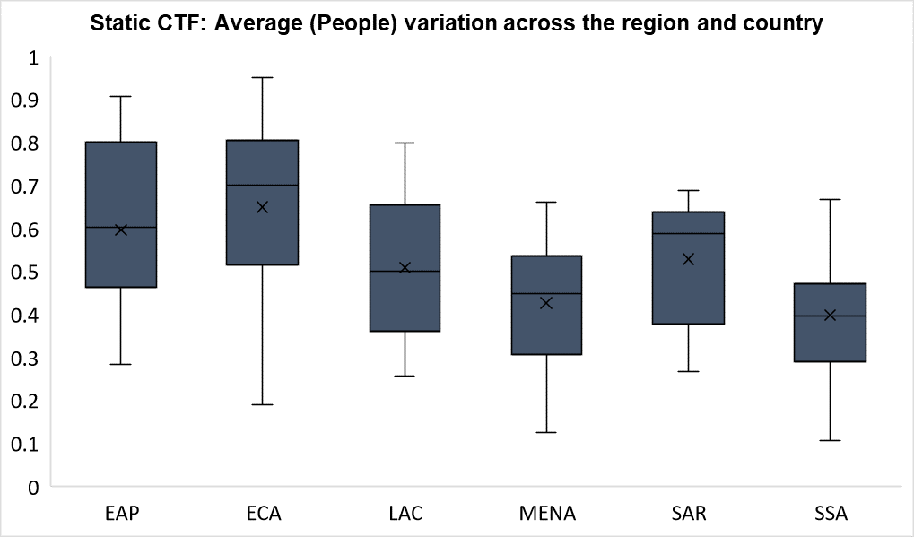
People variable static that includes: vdem_core_v2peasjpol vdem_core_v2stcritrecadm vdem_core_v2peasjsoecon

Slide 23
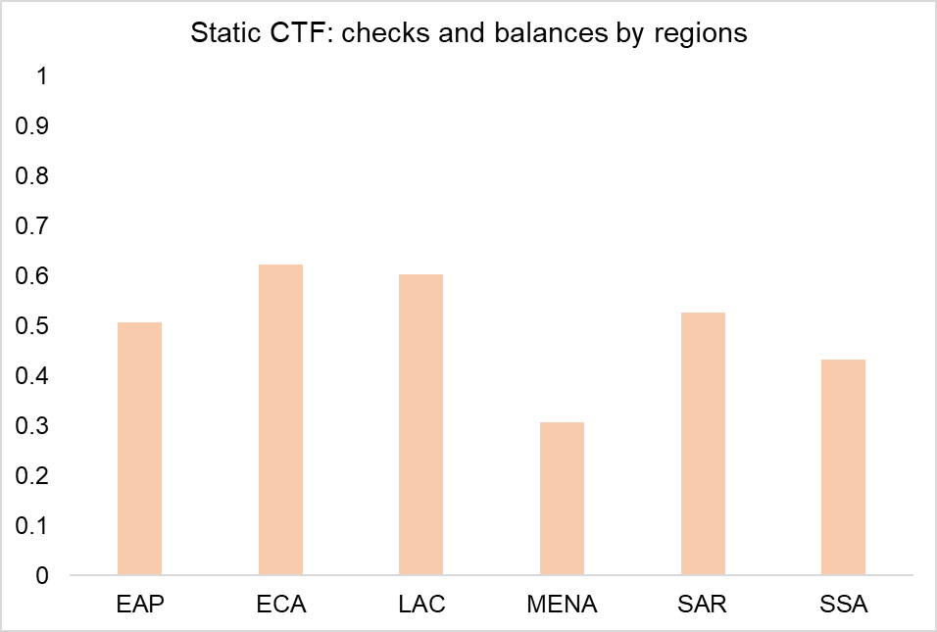
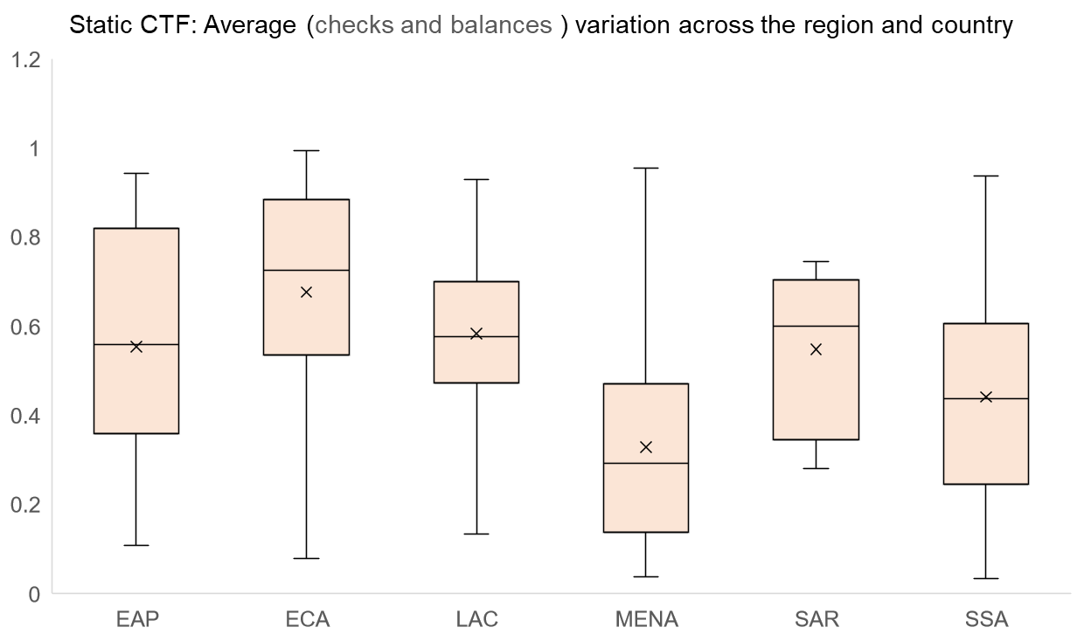
Checks and balances variable static that includes: wjp_rol_1 vdem_core_v2xlg_legcon bs_bti_si bs_bti_q3_1 bs_bti_q2_1

Slide 24
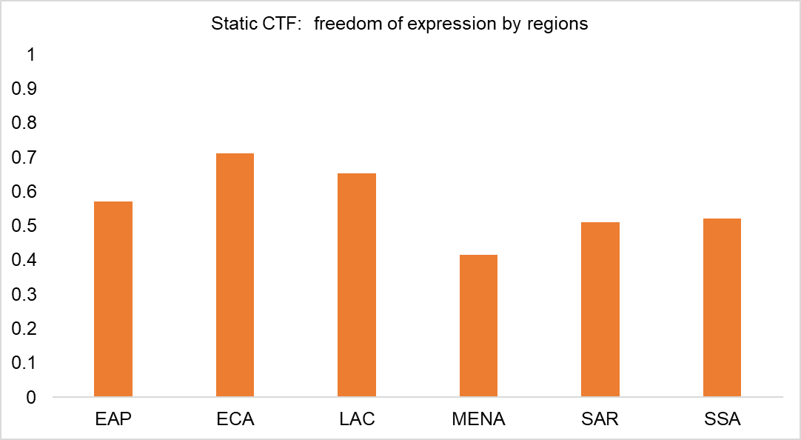
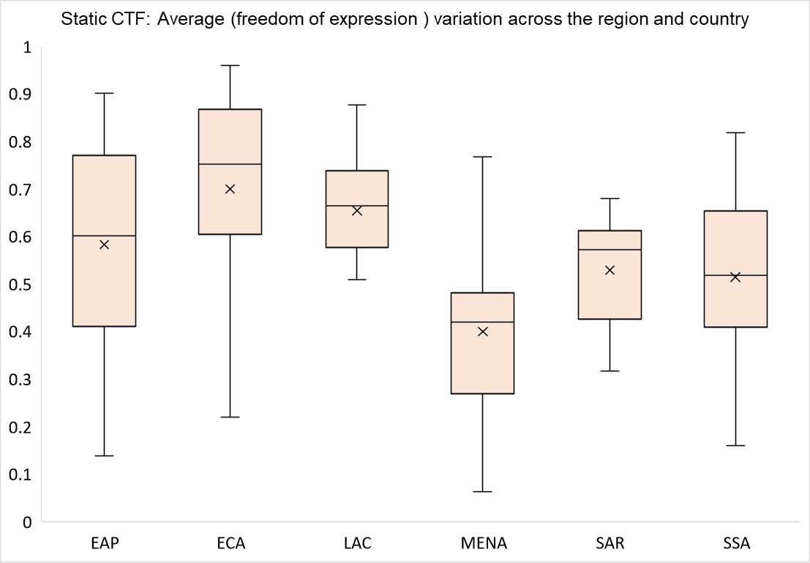
Freedom of expression variable static that includes: rwb_pfi_index vdem_core_v2clacfree wjp_rol_4_5 wjp_rol_4_4 wjp_rol_4_6 vdem_core_v2cldiscm vdem_core_v2cldiscw

Slide 25
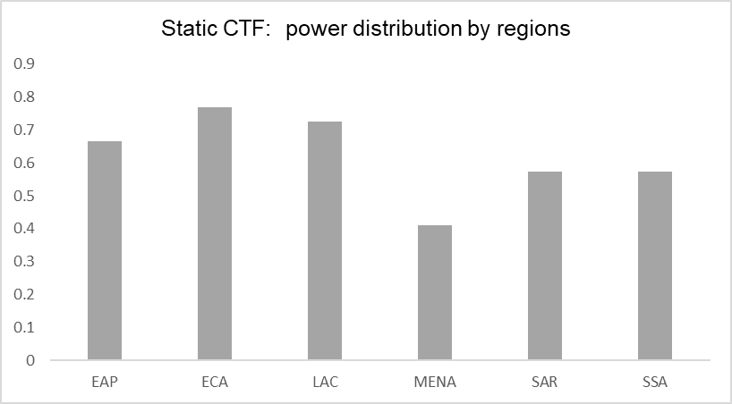
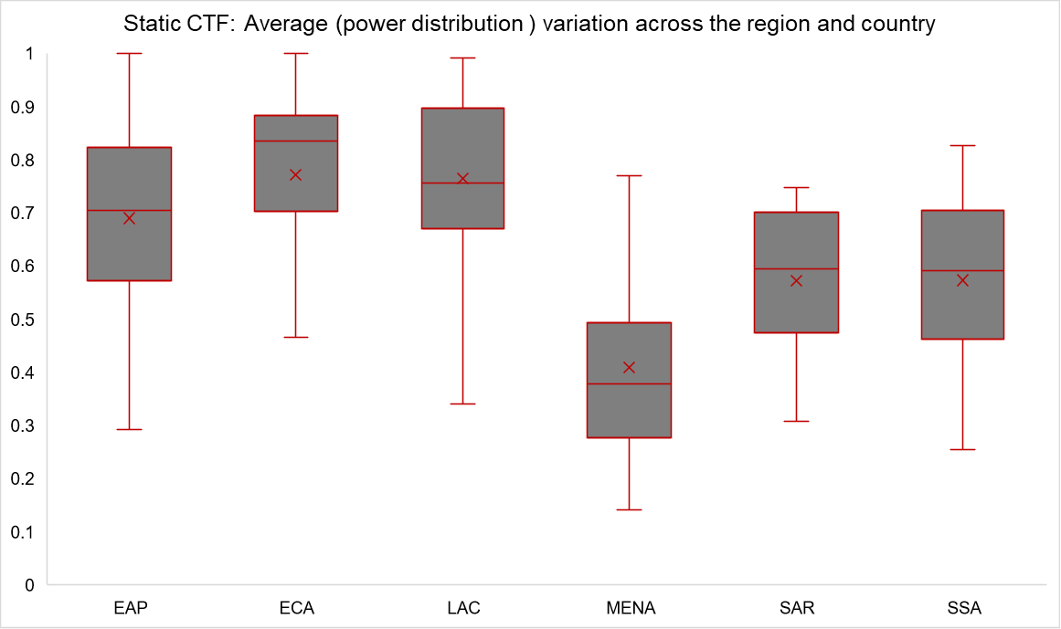
Power distribution variable static that includes: fh_fiw_pr_rating vdem_core_v2pepwrses vdem_core_v2pepwrsoc vdem_core_v2pepwrgen vdem_core_v2x_gender wb_wbl_social

Slide 26
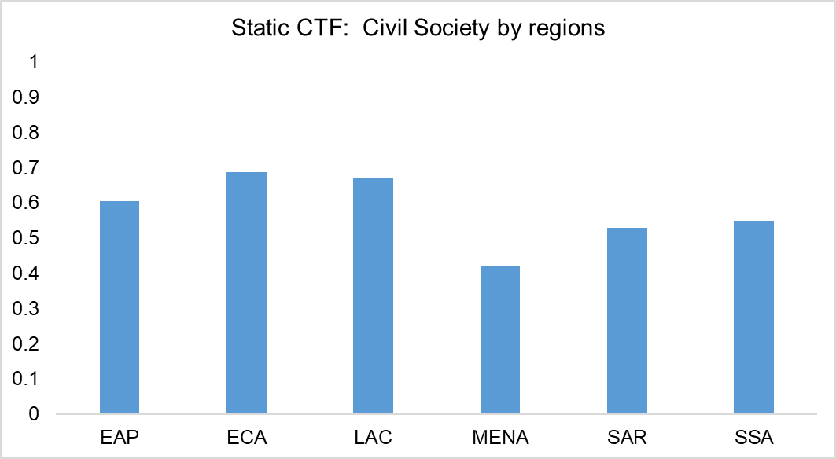
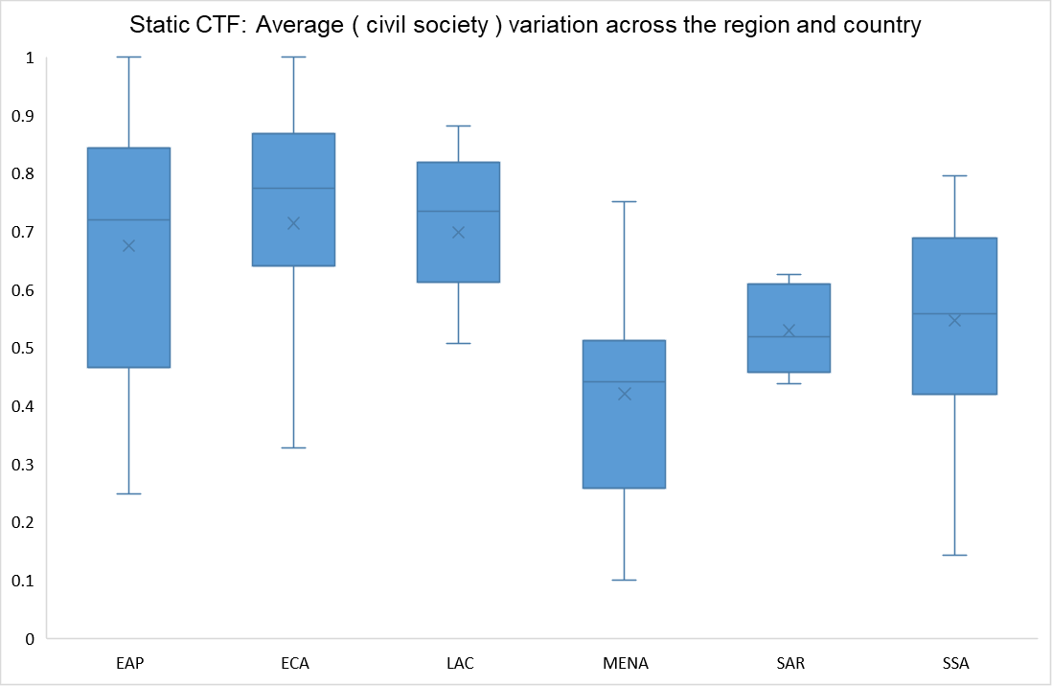
civil society variable static that includes: fh_fiw_cl_rating bs_bti_q2_3 vdem_core_v2cacamps vdem_core_v2x_cspart vdem_core_v2cseeorgs vdem_core_v2csreprss vdem_core_v2dlengage wjp_rol_4_7

Slide 27
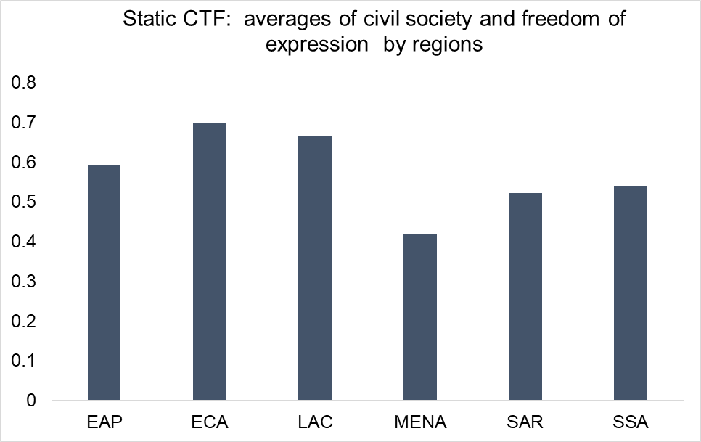
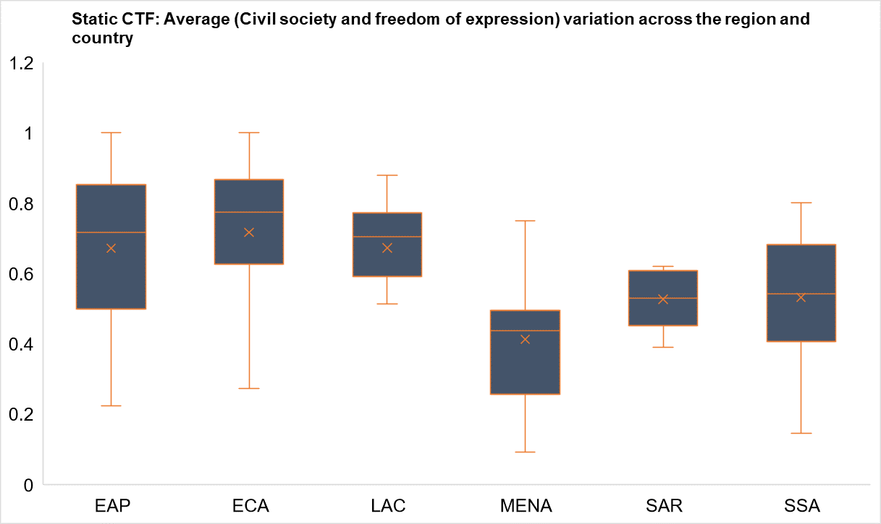
Freedom of expression and civil society variable static that includes variable, "wjp_rol_4_5", "wjp_rol_4_4", "wjp_rol_4_6", "vdem_core_v2cldiscm") ///
| inlist(variable, "vdem_core_v2cldiscw", "fh_fiw_cl_rating", "bs_bti_q2_3", "vdem_core_v2cacamps", "vdem_core_v2x_cspart") ///
| inlist(variable, "vdem_core_v2cseeorgs", "vdem_core_v2csreprss", "vdem_core_v2dlengage", "wjp_rol_4_7")

Slide 28
Org capacity and outcome variables
Updated: 12-12-2023

Slide 29
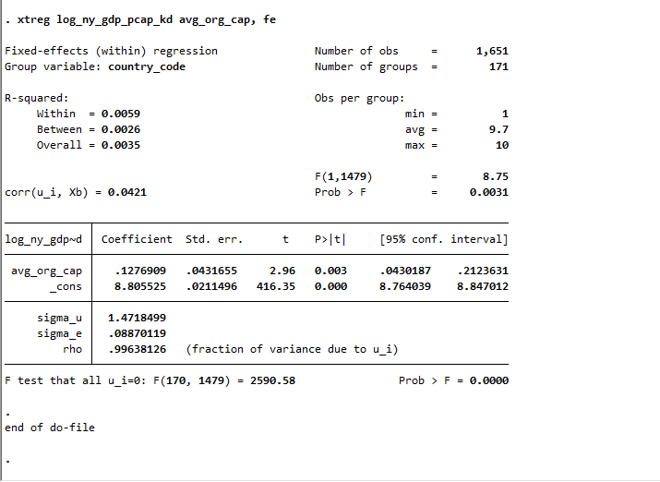
xtreg log_ny_gdp_pcap_kd avg_org_cap, fe

Slide 30
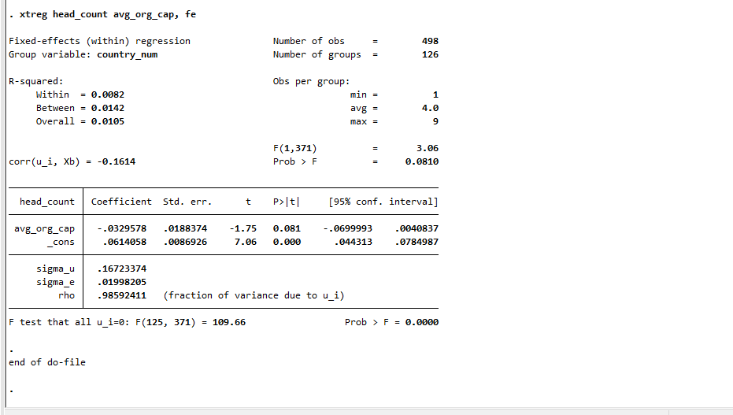
xtreg head_count avg_org_cap, fe

Slide 31
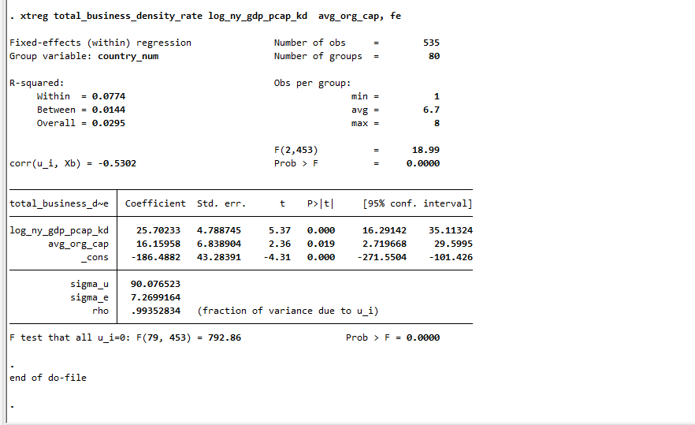
xtreg total_business_density_rate log_ny_gdp_pcap_kd avg_org_cap, fe

Slide 32
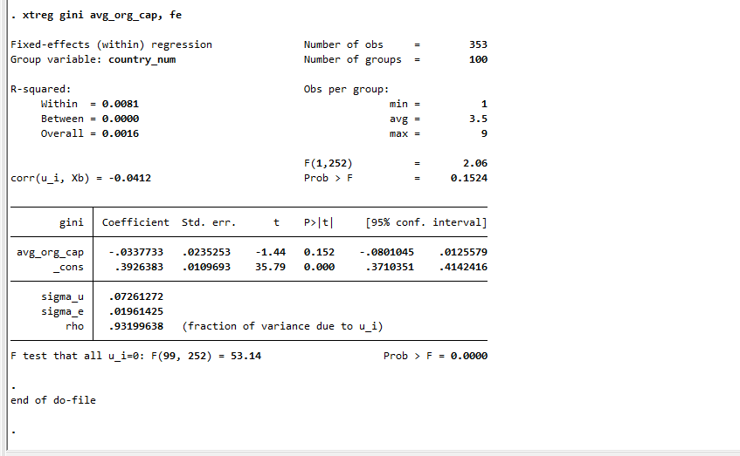
xtreg gini avg_org_cap, fe

Slide 33
Decision making process and outcome variables
Updated: 12-12-2023

Slide 34
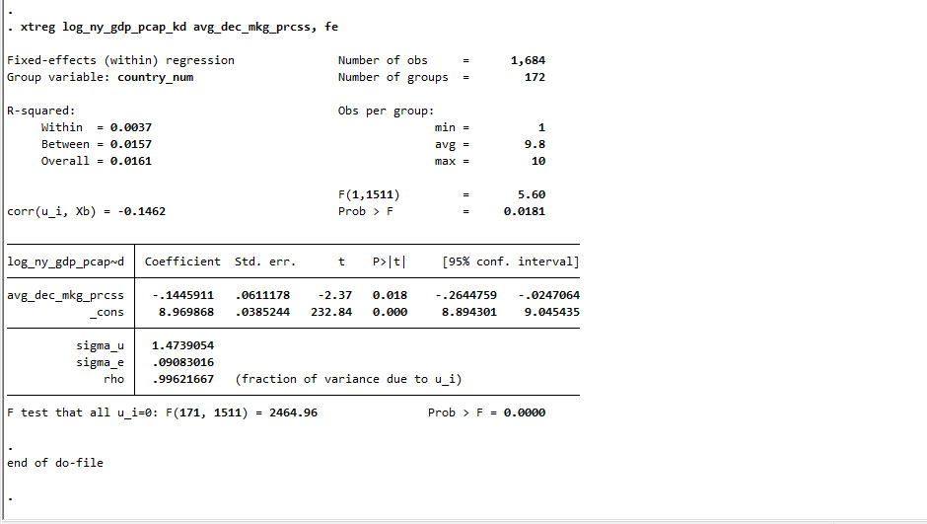
xtreg log_ny_gdp_pcap_kd avg_dec_mkg_prcss, fe

Slide 35
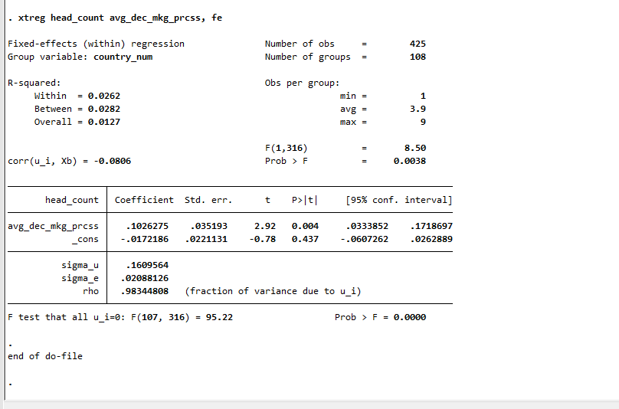
xtreg head_count avg_dec_mkg_prcss, fe

Slide 36
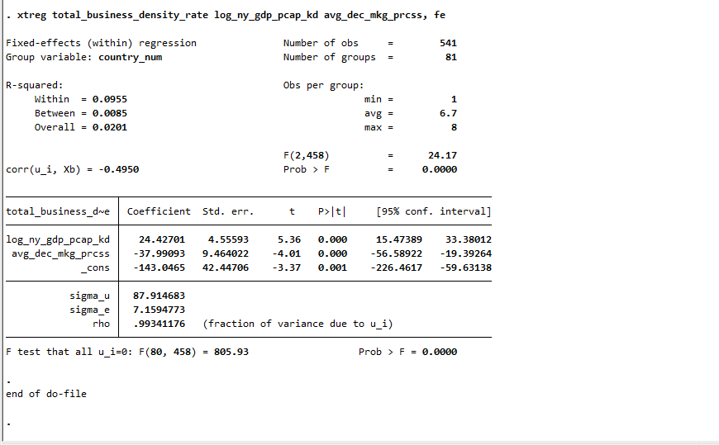
xtreg total_new_business_density_rate log_ny_gdp_pcap_kd avg_dec_mkg_prcss, fe

Slide 37
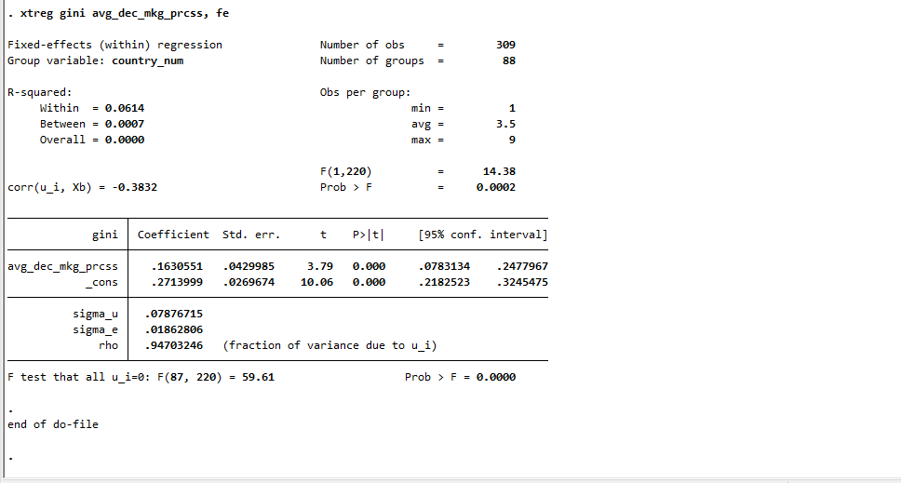
xtreg gini avg_dec_mkg_prcss, fe

Slide 38
People and outcome variables

Slide 39
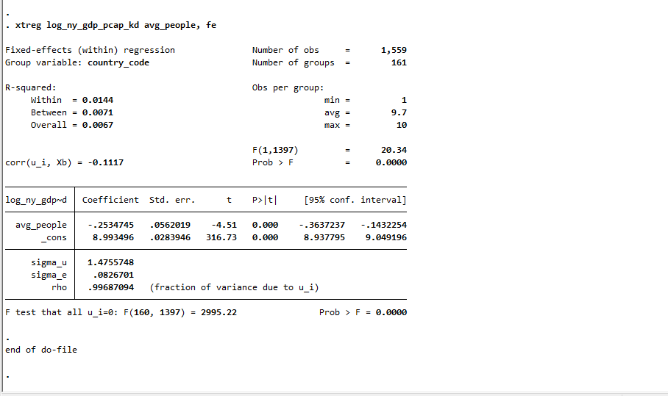
xtreg log_ny_gdp_pcap_kd avg_people, fe

Slide 40
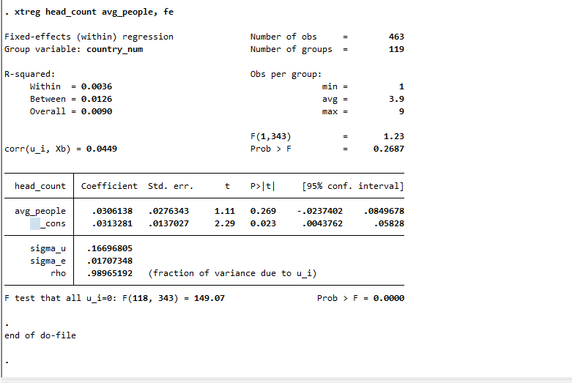
xtreg head_count avg_people, fe

Slide 41
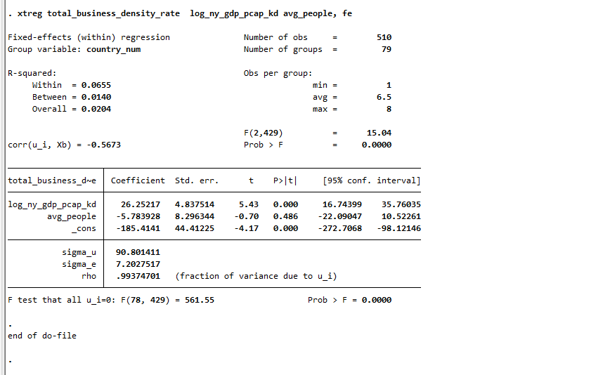
xtreg total_business_density_rate log_ny_gdp_pcap_kd avg_people, fe

Slide 42
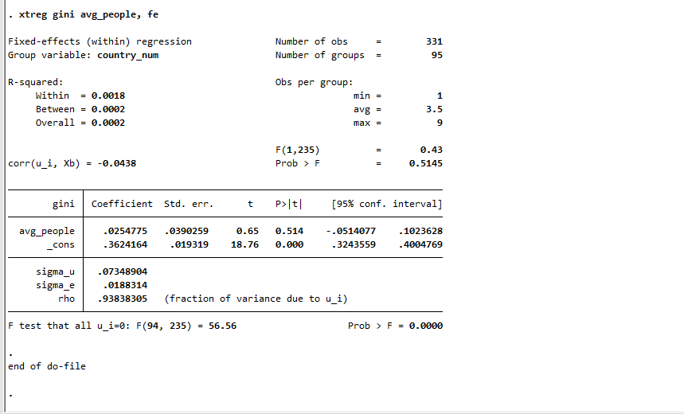
xtreg gini avg_people, fe

Slide 43
Money and outcome variables

Slide 44
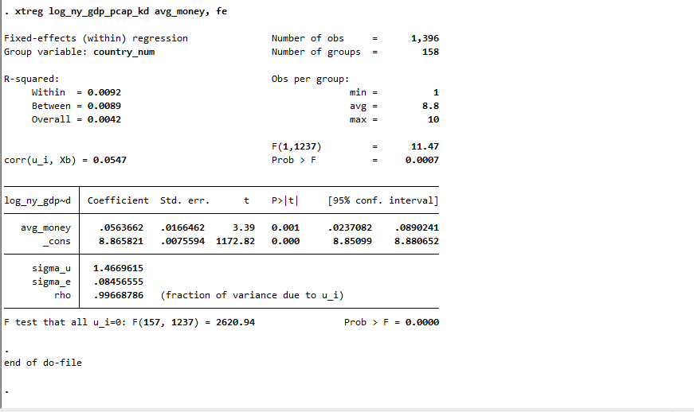
xtreg log_ny_gdp_pcap_kd avg_money, fe

Slide 45
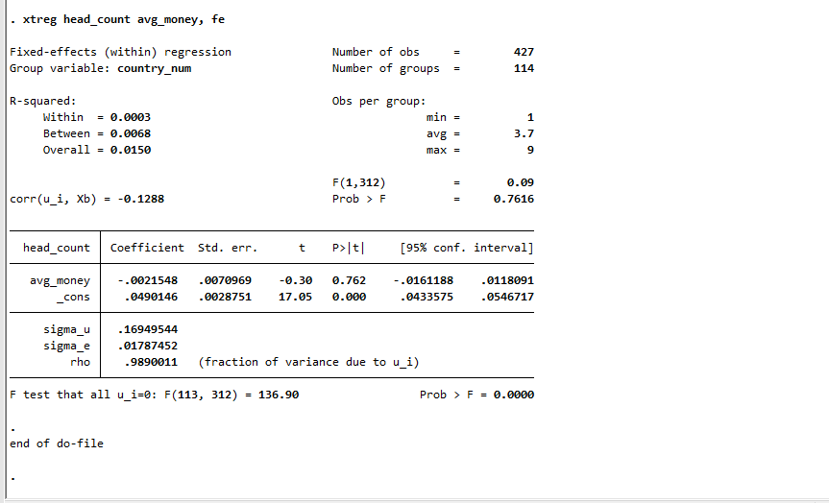
xtreg head_count avg_money, fe

Slide 46
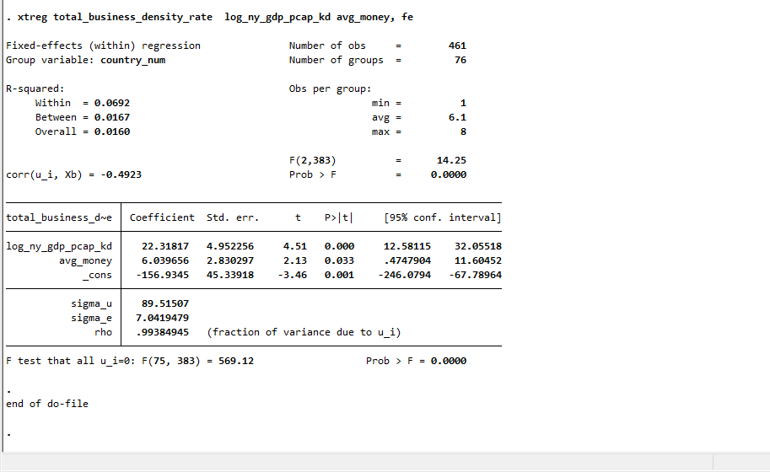
xtreg total_new_business_density_rate log_ny_gdp_pcap_kd avg_money, fe

Slide 47
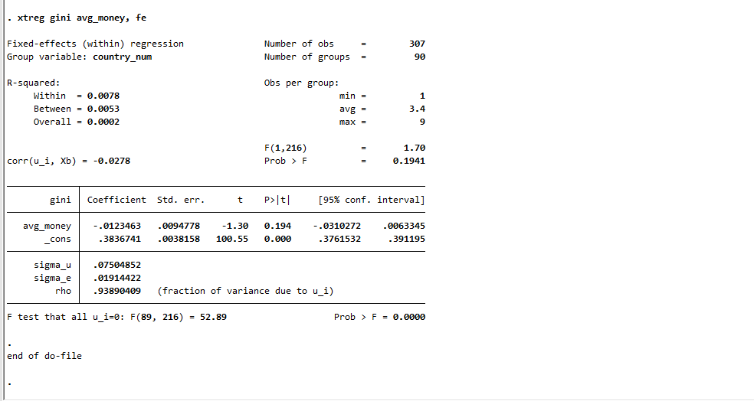
xtreg gini avg_money, fe

Slide 48
System and outcome variables

Slide 49
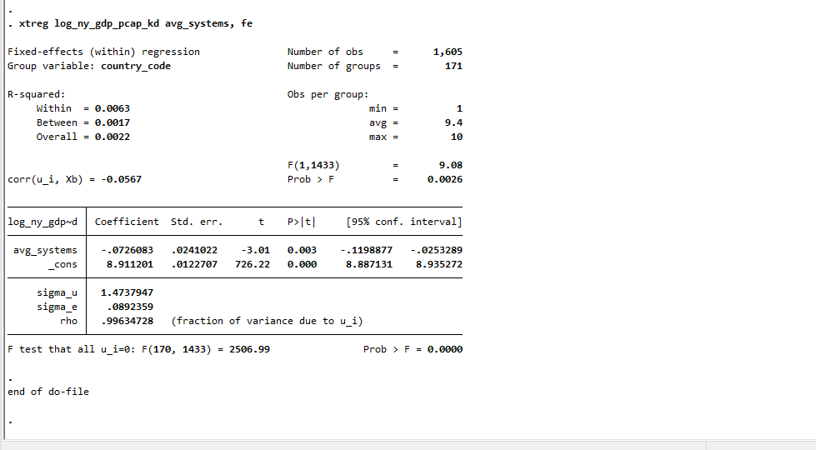
xtreg log_ny_gdp_pcap_kd avg_systems, fe

Slide 50
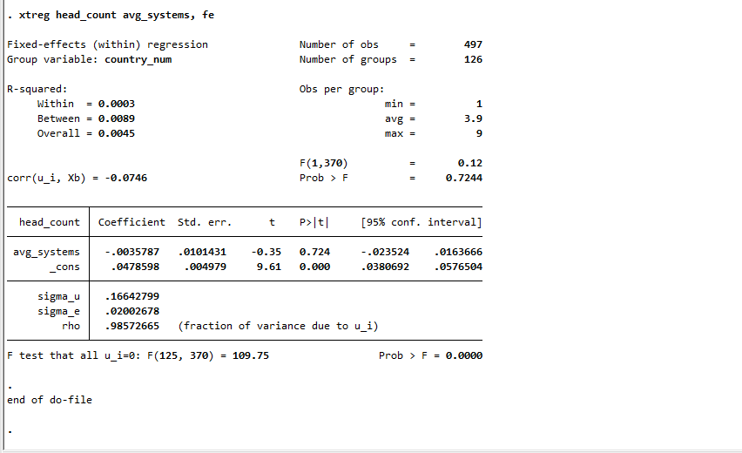
xtreg head_count avg_systems, fe

Slide 51

xtreg total_new_business_density_rate log_ny_gdp_pcap_kd avg_systems, fe

Slide 52

xtreg gini avg_systems, fe

Slide 53
org capacity and decision making (1 regression) and outcome variables

Slide 54

xtreg log_ny_gdp_pcap_kd avg_dec_mkg_prcss avg_org_cap, fe

Slide 55

xtreg head_count avg_dec_mkg_prcss avg_org_cap, fe

Slide 56

xtreg total_new_business_density_rate log_ny_gdp_pcap_kd avg_dec_mkg_prcss avg_org_cap, fe

Slide 57

xtreg gini avg_dec_mkg_prcss avg_org_cap, fe

Slide 58
people and money and systems (1 regression) and outcome variables

Slide 59

xtreg log_ny_gdp_pcap_kd avg_systems avg_money avg_people, fe

Slide 60

xtreg head_count avg_systems avg_money avg_people, fe

Slide 61

xtreg total_new_business_density_rate log_ny_gdp_pcap_kd avg_systems avg_money avg_people, fe

Slide 62

xtreg gini avg_systems avg_money avg_people, fe

Slide 63
Checks and balances and freedom of expression and power distribution and civil society (1 regression)
Updated: 1-2-2024

Slide 64

xtreg log_ny_gdp_pcap_kd avg_check_balance avg_freedom_expr avg_power_distribution avg_civil_society , fe

Slide 65

xtreg head_count avg_check_balance avg_freedom_expr avg_power_distribution avg_civil_society, fe

Slide 66

xtreg total_business_density_rate log_ny_gdp_pcap_kd avg_check_balance avg_freedom_expr avg_power_distribution avg_civil_society, fe

Slide 67

xtreg gini avg_check_balance avg_freedom_expr avg_power_distribution avg_civil_society, fe

Slide 68
Tuesday 21-11-2023 Next Achieved slides
Notes:
Footnote:
The following regions dropped because they appear in the data under the country name EAP, ECA, Arab World EU, Middle income, OECD members, Low & middle income, LAC, Low-income South Asia, Lower middle income, Central Europe and the Baltics, North America, Upper middle income, SSA, MENA, High income. Also, dropped country code, like small islands/economies "TUV", "NRU", "KIR", "NHL", "FSM", "STP", "VCT", "TCA", "SXM", "LCA", "CPV" from the sample to prepare chart.
Form dynamic we dropped all observations from the dataset where the count of non-missing values for countries within each group observed by variable is less than 100.

Slide 69

Public Institution – overview Public Human Resource Management Institutions
Notes:
Footnote:
The following regions dropped because they appear in the data under the country name EAP, ECA, Arab World EU, Middle income, OECD members, Low & middle income, LAC, Low-income South Asia, Lower middle income, Central Europe and the Baltics, North America, Upper middle income, SSA, MENA, High income. Also, dropped country code, like small islands/economies "TUV", "NRU", "KIR", "NHL", "FSM", "STP", "VCT", "TCA", "SXM", "LCA", "CPV" from the sample to prepare chart.
Form dynamic we dropped all observations from the dataset where the count of non-missing values for countries within each group observed by variable is less than 100.

Slide 70

Public Institution – overview: An alternative version of dynamic org capacity that includes only: vdem_core_v2peasjpol vdem_core_v2stcritrecadm vdem_core_v2peasjsoecon rise_ee_4 wjp_rol_3_2 wjp_rol_3_4 wjp_rol_3_1 ibp_obs_obi

Slide 71

Public Institution – overview: People vs family: Public Human Resource Management Institutions vdem_core_v2peasjpol : vdem_core_v2stcritrecadm: vdem_core_v2peasjsoecon:
Notes:
vdem_core_v2peasjpol : Captures whether state jobs equally open to qualified individuals regardless of their association with a political group (0 to 4 scoring) vdem_core_v2stcritrecadm: Measures the extent to which appointment decisions in the state administration are based on personal and political connections as opposed to skills and merit (0 to 4 scoring) vdem_core_v2peasjsoecon: Captures if state jobs are equally open to qualified individuals regardless of socio-economic position

Slide 72

xtreg gdppc avg_org_cap, fe
outreg2 using "regression_results.xlsx", replace
2. xtreg gdppc avg_dec_mkg_prcss, fe
outreg2 using "regression_results.xlsx", replace
3. xtreg firm_density_rate avg_org_cap gdppc, fe
outreg2 using "regression_results.xlsx", replace
4. xtreg firm_density_rate avg_dec_mkg_prcss gdppc, fe
outreg2 using "regression_results.xlsx", replace
Next: poverty and inequality regressions vs other var.
Notes:
The coefficient estimates are the "gdppc" and "avg_org_cap" in rows. The variable "gdppc" does not have a statistically significant effect on the dependent variable. Likewise, variable "avg_org_cap" does not have a statistically significant effect on the dependent variable.
Coefficient estimates for the independent variables:
avg_org_cap: The estimated coefficient for this variable is 15.71582. it is not statistically significant at conventional significance levels (p-value = 0.168).
gdppc: It is omitted from the model, indicated by "0 (omitted)."
avg_dec_mkg_prcss: Coefficient for this variable is -36.27991. It is statistically significant at a significance level of 0.05 (p-value = 0.014).

Slide 73

xtreg gdppc avg_org_cap, fe
outreg2 using "regression_results.xlsx", replace
2. xtreg gdppc avg_dec_mkg_prcss, fe
outreg2 using "regression_results.xlsx", replace
3. xtreg firm_density_rate avg_org_cap gdppc, fe
outreg2 using "regression_results.xlsx", replace
4. xtreg firm_density_rate avg_dec_mkg_prcss gdppc, fe
outreg2 using "regression_results.xlsx", replace
Next: poverty and inequality regressions vs other var.
Notes:
The coefficient estimates are the "gdppc" and "avg_org_cap" in rows. The variable "gdppc" does not have a statistically significant effect on the dependent variable. Likewise, variable "avg_org_cap" does not have a statistically significant effect on the dependent variable.
Coefficient estimates for the independent variables:
avg_org_cap: The estimated coefficient for this variable is 15.71582. it is not statistically significant at conventional significance levels (p-value = 0.168).
gdppc: It is omitted from the model, indicated by "0 (omitted)."
avg_dec_mkg_prcss: Coefficient for this variable is -36.27991. It is statistically significant at a significance level of 0.05 (p-value = 0.014).

Slide 74




Public Institution – overview:
Note: These variables == "bs_bti_q3_1" |variable == "bs_bti_q2_1" | variable == "bs_bti_q2_3"|variable == "bs_bti_si“. Categories of these in the original/xls are missing (.) file hence if I keep dec_mkg_prcss ==1 – these var get dropped so I fix the re-run the code to keep dec_mkg_prcss==0 to prepare plot separately. Please see next chart.
Notes:
Footnote:
The following regions dropped because they appear in the data under the country name EAP, ECA, Arab World EU, Middle income, OECD members, Low & middle income, LAC, Low-income South Asia, Lower middle income, Central Europe and the Baltics, North America, Upper middle income, SSA, MENA, High income. Also, dropped country code, like small islands/economies "TUV", "NRU", "KIR", "NHL", "FSM", "STP", "VCT", "TCA", "SXM", "LCA", "CPV" from the sample to prepare chart.
Form dynamic we dropped all observations from the dataset where the count of non-missing values for countries within each group observed by variable is less than 100.
All countries/variables have equal number of non-missing values.

Slide 75


Public Institution – overview:
Chart shows:
org_cap:
bs_bti_q15_1
decision_making_processes:
bs_bti_q3_1,
bs_bti_q2_1,
bs_bti_q2_3
bs_bti_si
Notes:
Footnote:
The following regions dropped because they appear in the data under the country name EAP, ECA, Arab World EU, Middle income, OECD members, Low & middle income, LAC, Low-income South Asia, Lower middle income, Central Europe and the Baltics, North America, Upper middle income, SSA, MENA, High income. Also, dropped country code, like small islands/economies "TUV", "NRU", "KIR", "NHL", "FSM", "STP", "VCT", "TCA", "SXM", "LCA", "CPV" from the sample to prepare chart.
Form dynamic we dropped all observations from the dataset where the count of non-missing values for countries within each group observed by variable is less than 100.
All countries/variables have equal number of non-missing values.

Slide 76

Public Institution – overview:
Chart of
Chart of
Note: These variables == "bs_bti_q3_1" |variable == "bs_bti_q2_1" | variable == "bs_bti_q2_3"|variable == "bs_bti_si“. Categories of these in the original/xls are missing (.) data classification.xlsx file hence if I keep dec_mkg_prcss ==1 – these var get dropped so I fix code to re-run
keep dec_mkg_prcss==0 to prepare plot separately.
Notes:
Footnote:
The following regions dropped because they appear in the data under the country name EAP, ECA, Arab World EU, Middle income, OECD members, Low & middle income, LAC, Low-income South Asia, Lower middle income, Central Europe and the Baltics, North America, Upper middle income, SSA, MENA, High income. Also, dropped country code, like small islands/economies "TUV", "NRU", "KIR", "NHL", "FSM", "STP", "VCT", "TCA", "SXM", "LCA", "CPV" from the sample to prepare chart.
Form dynamic we dropped all observations from the dataset where the count of non-missing values for countries within each group observed by variable is less than 100.
All countries/variables have equal number of non-missing values.
What drive each basket (add a point). Prepare Whisker for each basket (Rita) will share. Check if all var is for all years – if not drop them. ibp_obs_obi!=. This is also for

Slide 77

Chart shows:
org_cap:
bs_bti_q15_1
decision_making_processes:
bs_bti_q3_1,
bs_bti_q2_1,
bs_bti_q2_3
bs_bti_si

Slide 78

A systems variable static that includes: wb_gtmi_gtei / wb_gtmi_psdi wb_gtmi_dcei wb_gtmi_cgsi / spi_census_and_survey_index spi_std_and_methods/ wjp_rol_3_2 / wjp_rol_3_4 / wjp_rol_3_1

Slide 79

MIS Year in which a system) became operational. total 9 FMIS, Customs, Tax MIS, Debt Mgt, Treasury Single Account (TSA), eProcurement , Payroll ,HRMIS system, and Public Investment Management Systems.

Slide 80


Public Institution – overview:

Slide 81


Public Institution – overview:

Slide 82


Public Institution – overview:
Notes:
Footnote:
The following regions dropped because they appear in the data under the country name EAP, ECA, Arab World EU, Middle income, OECD members, Low & middle income, LAC, Low-income South Asia, Lower middle income, Central Europe and the Baltics, North America, Upper middle income, SSA, MENA, High income. Also, dropped country code, like small islands/economies "TUV", "NRU", "KIR", "NHL", "FSM", "STP", "VCT", "TCA", "SXM", "LCA", "CPV" from the sample to prepare chart.
Form dynamic we dropped all observations from the dataset where the count of non-missing values for countries within each group observed by variable is less than 100.

Slide 83

Public Institution – overview: Decision Making Processes and Organizational Capacity (avg) by regions

Slide 84





Public Institution – overview: by regions and years

Slide 85

Public Institution – overview: Dynamic CTF: Money, People and Systems (avg) by regions.

Slide 86

Public Institution – complex interplay of below factors? Decision Making Processes and Organizational Capacity vs new business density and total number of firms (avg) by regions
Notes:
Talking points: Regions with robust decision-making processes and high organizational capacity tend to foster environments that are conducive to the creation of new businesses. Organizational capacity, particularly in terms of supportive institutions and resources, can positively impact the survival and growth of existing firms. This, in turn, influences the total number of firms in a region. The relationship can be reciprocal. A high density of new businesses and a large number of firms can also lead to improved organizational capacities and decision-making processes within the region. The competitive environment drives businesses and organizations to optimize their decision-making and improve their capacities to stay relevant and competitive.

Slide 87
CTF/Static: Institutions (Organizational Capacity, Decision_Making_processes, People, Money, and Systems) : Proportion of variables observed
Notes:
Decision Making processes variables: 23 var. organizational capacity 20 var. People 7 Variables. Money 7 Variables. System 7 Variables. I did not drop n-ctys

Slide 88


CTF Static vs Dynamic: Institutions and GDP per capita
GDP per capita and organization capacity (value): scatter plot comparing static and dynamic ctf.

Slide 89


CTF Static vs Dynamic: Institutions and GDP per capita
GDP per capita and decision-making process (value): : scatter plot comparing static and dynamic ctf.

Slide 90


CTF Static vs Dynamic: Institutions and GDP per capita
GDP per capita and people (value) : scatter plot comparing static and dynamic ctf.

Slide 91


CTF Static vs Dynamic: Institutions and GDP per capita
GDP per capita and money (value):: scatter plot comparing static and dynamic ctf.

Slide 92


CTF Static vs Dynamic: Institutions and GDP per capita
GDP per capita and systems: scatter plot comparing static and dynamic ctf.

Slide 93
Next/to-do-list : 1, 2, 3, and 4 vs Institution variables
Data cleaning and more plotting in-progress to distill message from lens of firm density, new firm density (the stock and the flow of firms per population)) vs Institution variables . Access here: https://www.worldbank.org/en/programs/entrepreneurship
Inequality, climate variable vs Institution variables.
And much more (such as db_variables: The complete list of indicators in our CLIAR data. (a) benchmarked_ctf (static) and (b) benchmark_dynamic_indicator. Gali?
Variation across regions, and continue improve the analysis and suggestions are welcome,?

